Slide 1


Electric Vehicles Market Size Analysis with Python
Table of Contents
Introduction
Overview
Objectives
Business Problem / Stakeholder Concerns
3. Importing Libraries
4. Loading Data
5. Generating Comprehensive Data Profile Report Using Pandas Profiling
6. Methodology
Data Collection
Data Cleaning
Exploratory Data Analysis (EDA)
Outlier Detection to All Numerical Columns and Handling
Checking or Ensuring Final Cleaned Dataset
7. Analysis
EV Growth Trends Over Time
Regional Registration Patterns
EV Category Breakdown
Brand and Model Analysis
Electric Range Trends
Market Size Growth
8. Conclusion or Summary

Slide 2
Overview:
The "Electric Vehicles Market Size Analysis using Python" project focuses on exploring the rapidly expanding electric vehicle (EV) market, a key area of interest due to increasing environmental concerns, regulatory pressures, and consumer demand for sustainable transportation. This analysis aims to provide valuable insights into the market's current state, trends in EV adoption, geographical distribution, and the popularity of different EV models. By leveraging data analysis techniques, the project seeks to uncover the drivers of growth in the EV market and assess its future potential, offering strategic insights for stakeholders.
Business Problem / Stakeholder Concerns
The aim is to analyze the market size of electric vehicles (EVs) in Washington State (WA). The insights will help stakeholders understand the distribution, trends, and demographics of EV ownership, and identify key factors influencing the adoption of EVs. The ultimate goal is to provide actionable insights for policymakers, automotive companies, and utility providers to support and enhance the growth of the EV market.
Main Challenges
Tracking EV Growth Trends: We are monitoring the increase in EV registrations over the years to understand market dynamics and growth patterns.
2. Identifying Regional Registration Patterns: We are determining regions with the highest density of EV registrations to tailor regional marketing strategies and distribution efforts.
3. Segmenting EV Categories: The data will be broken down by types of electric vehicles, such as battery electric vehicles (BEVs) and plug-in hybrid electric vehicles (PHEVs), to identify market preferences and trends.
4. Analyzing Brands and Models: Assessing the popularity of various EV brands and models to optimize product offerings and competitive positioning.

Slide 3
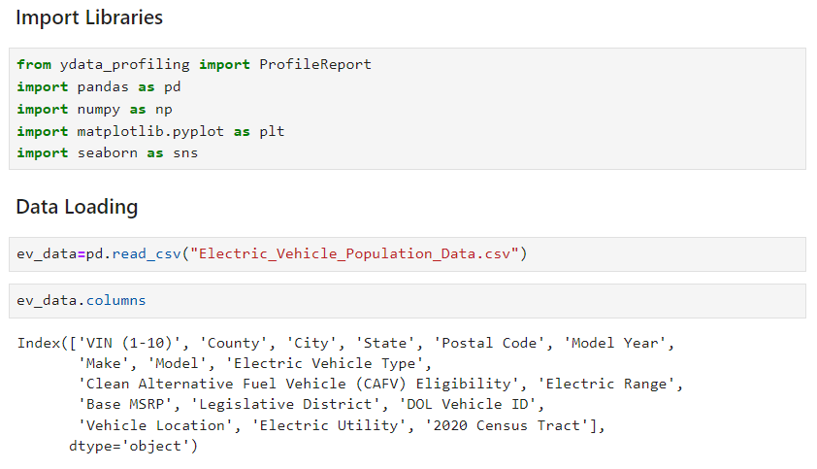
5. Evaluating Electric Range Trends: Investigating advancements in electric vehicle range to understand technological progress and consumer demands.
6. Estimating Market Size Growth: Projecting future growth of the EV market for strategic planning and investment decisions
Objectives
The objectives of the analysis include tracking the growth of electric vehicle (EV) registrations over time to understand how the market is expanding. It involves identifying regional patterns to pinpoint areas with the highest density of EV registrations. The analysis will segment the data by different types of electric vehicles, such as Battery Electric Vehicles (BEVs) and Plug-in Hybrid Electric Vehicles (PHEVs), to provide insights into the distribution of vehicle categories. Additionally, it aims to determine the most popular brands and models within the EV market. Evaluating the electric range trends will help in understanding technological advancements while estimating the future growth of the EV market will offer insights into its potential trajectory.

Slide 4
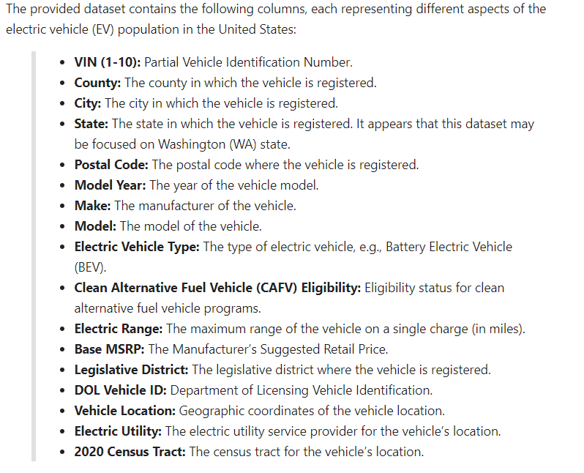
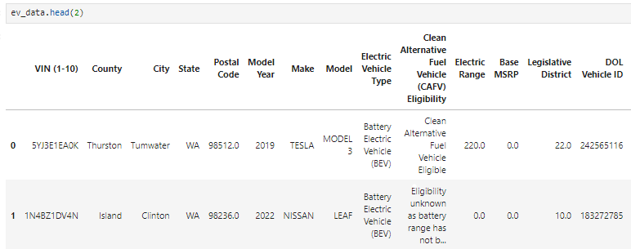

Slide 5
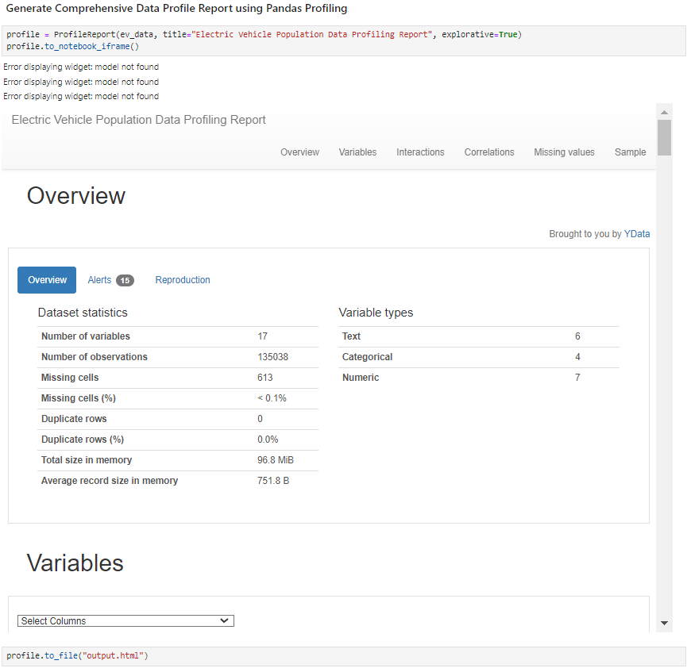

Slide 6
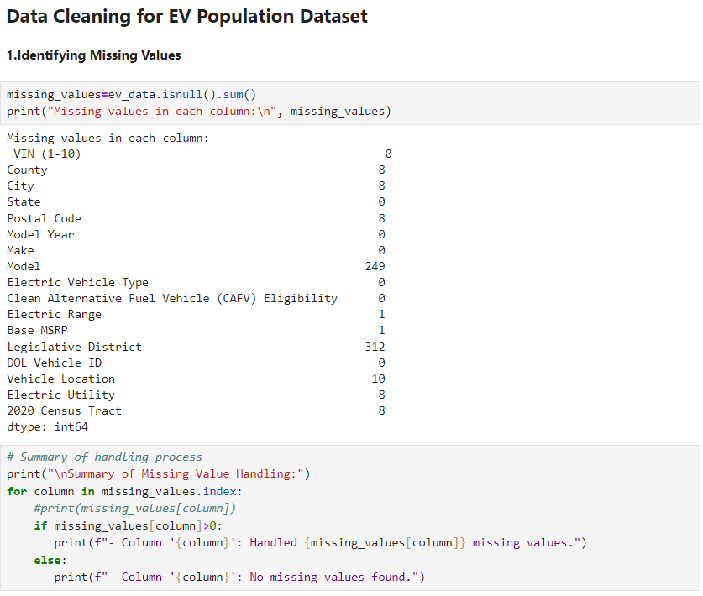
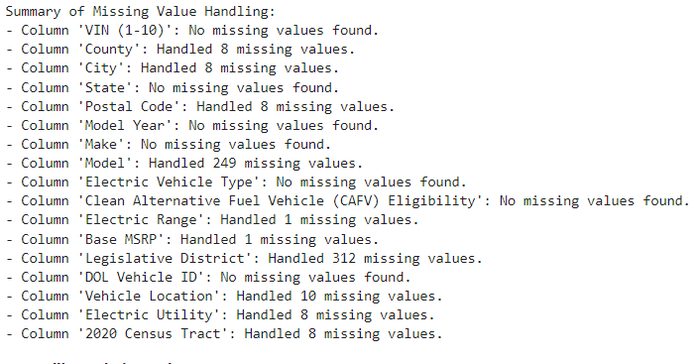

Slide 7
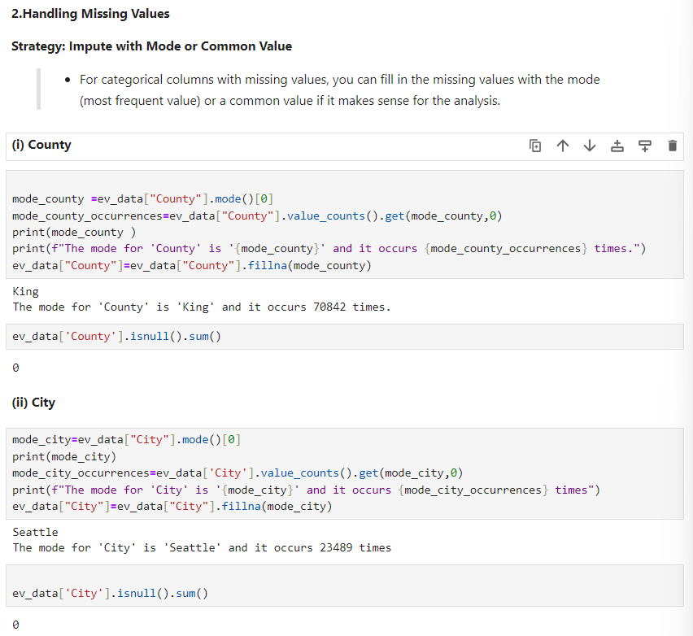


Slide 8
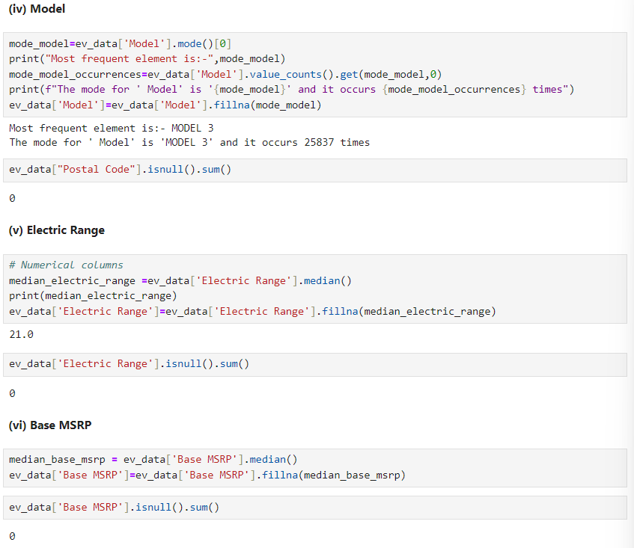
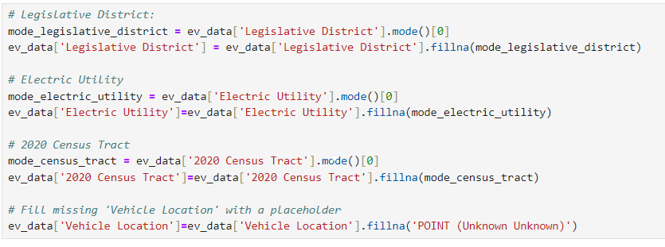

Slide 9
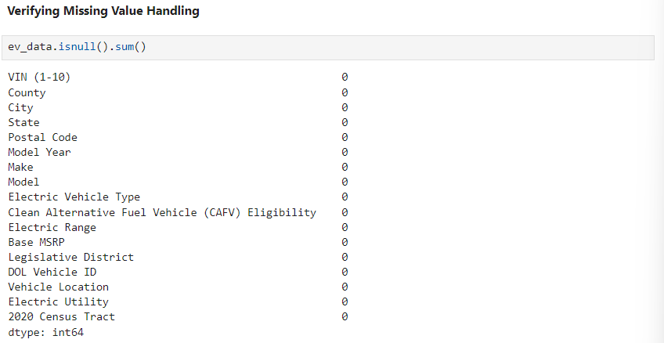
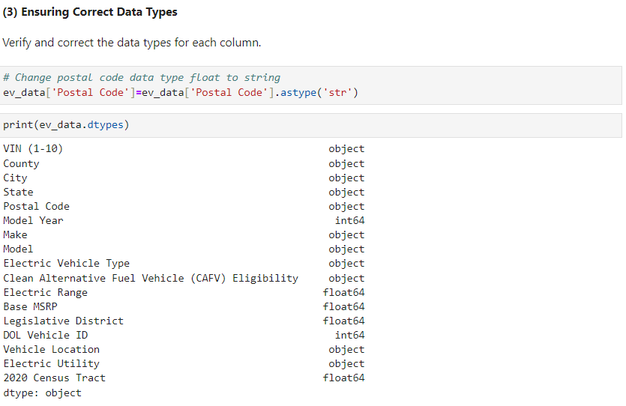

Slide 10

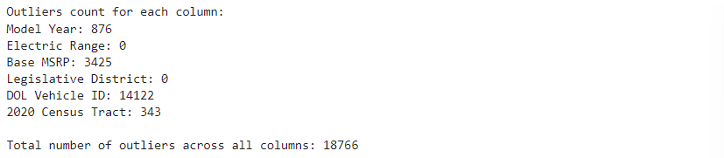

Slide 11


Slide 12


Slide 13
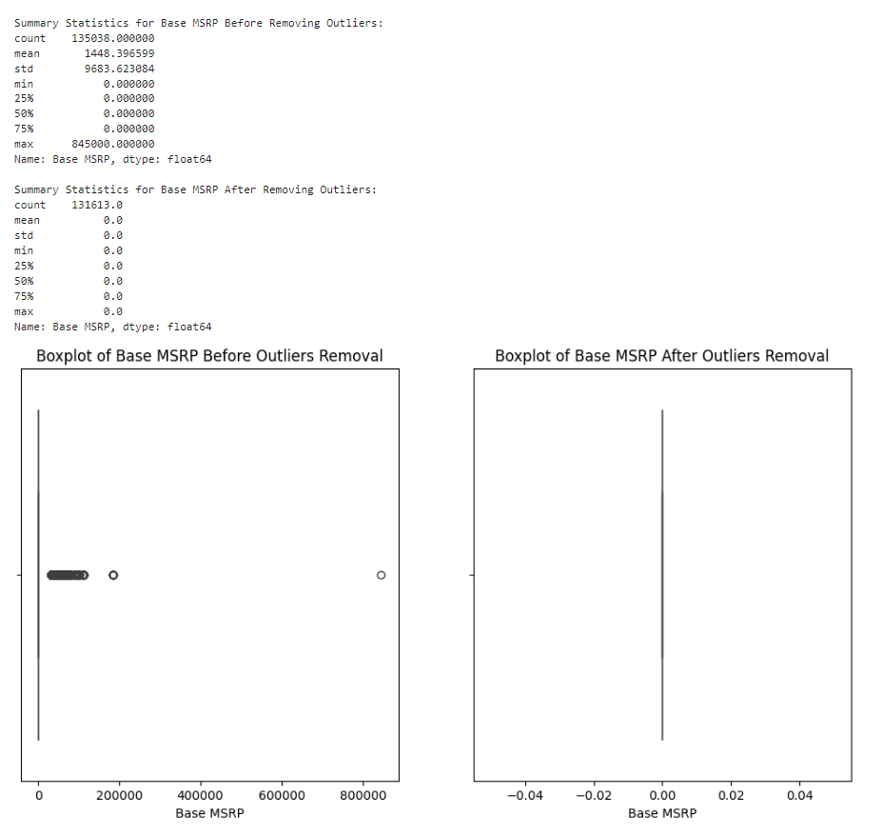

Slide 14
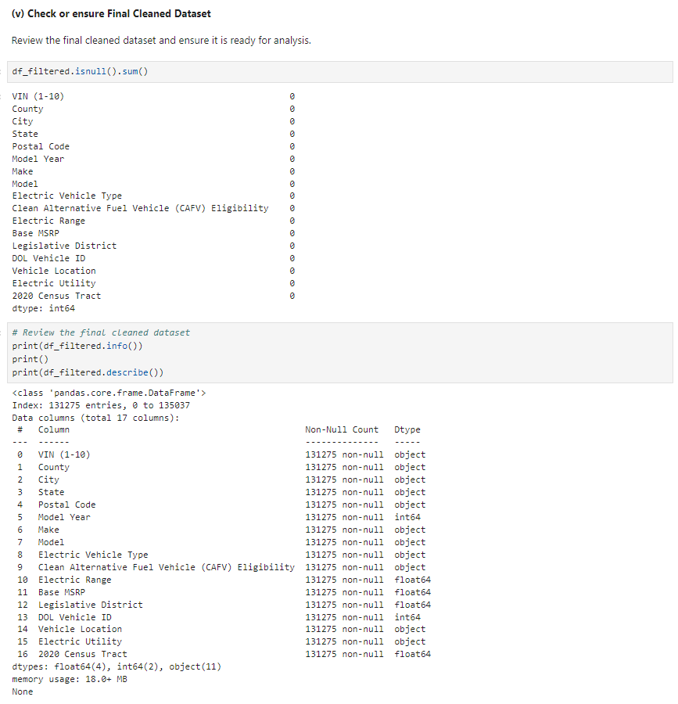

Slide 15
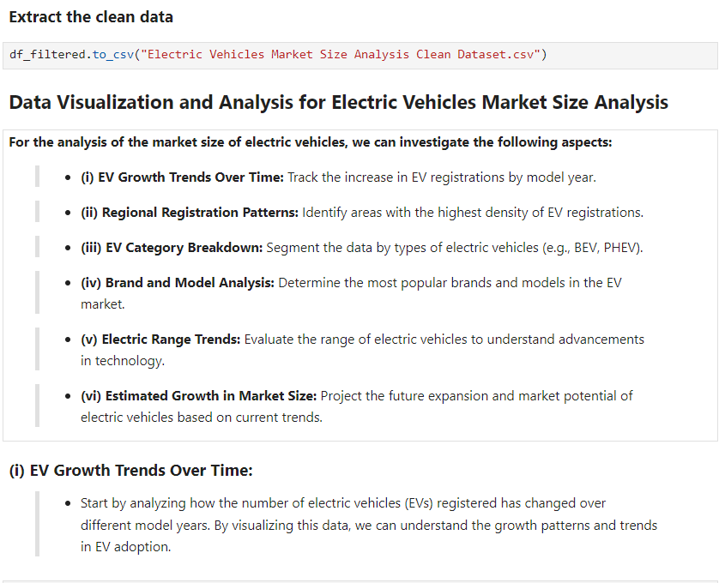
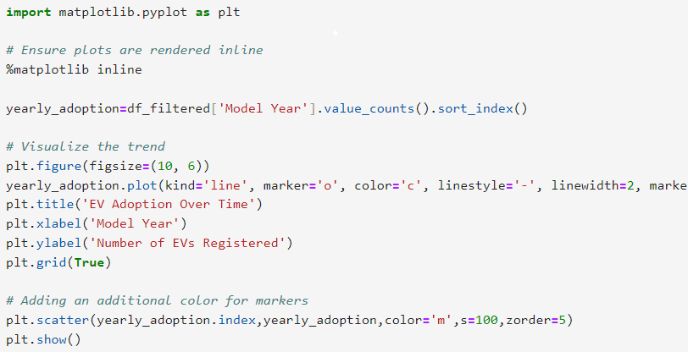

Slide 16
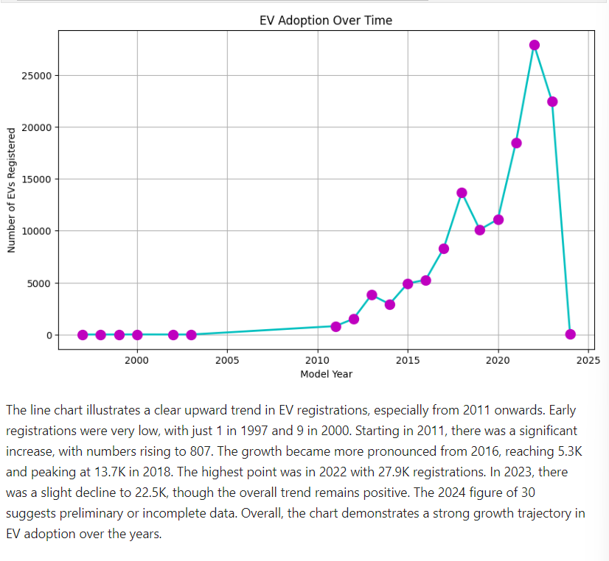
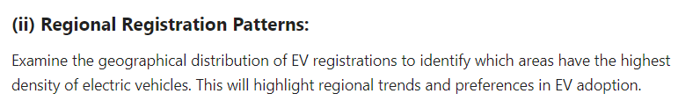

Slide 17
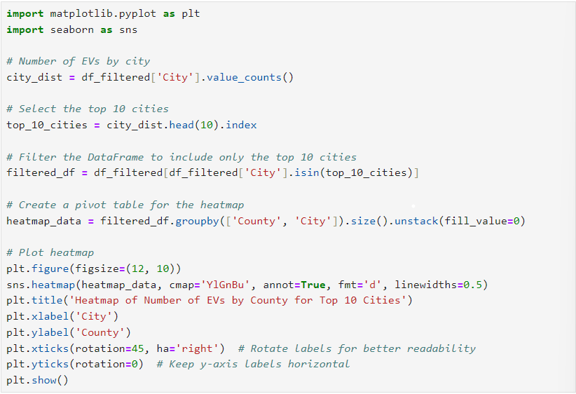
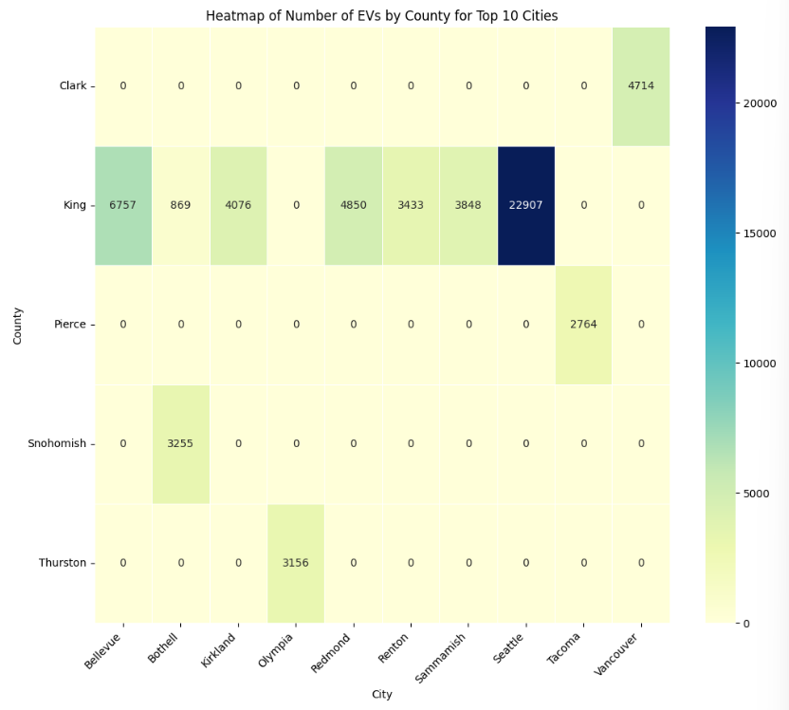

Slide 18
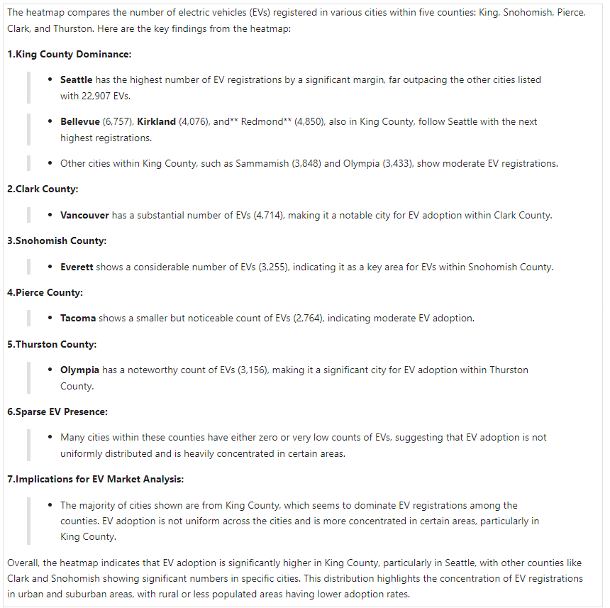

Slide 19
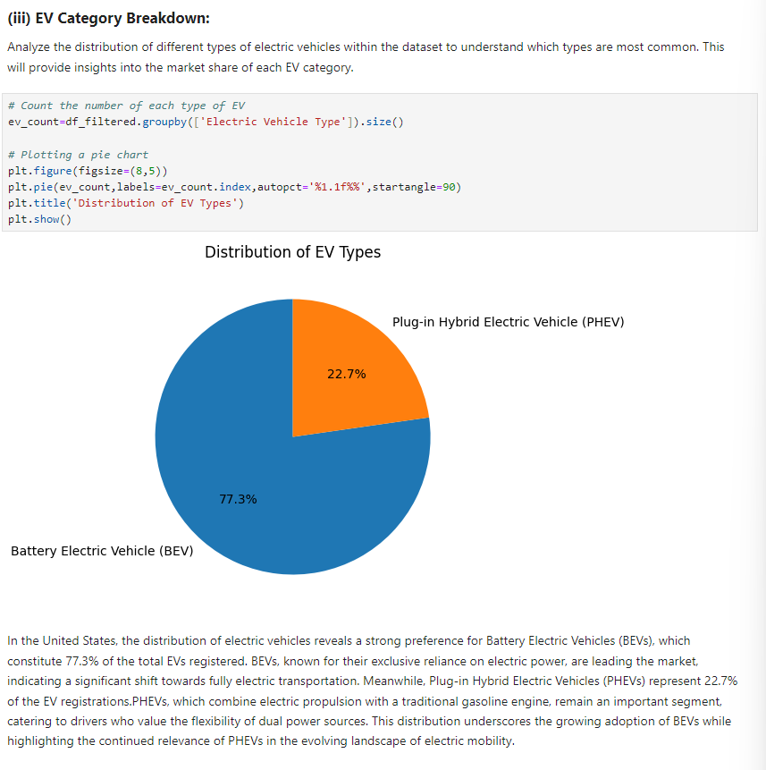

Slide 20
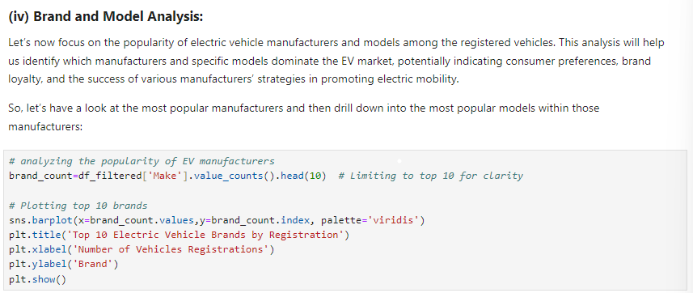
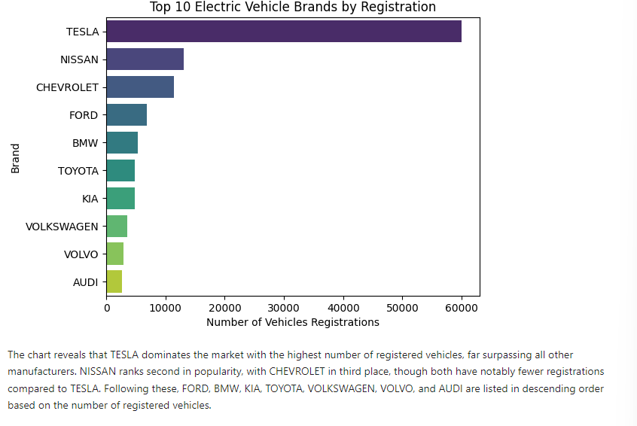

Slide 21
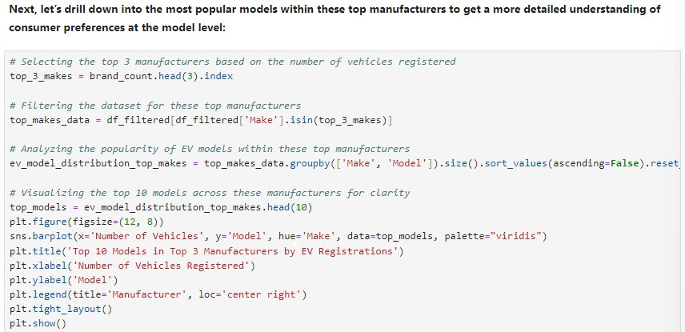
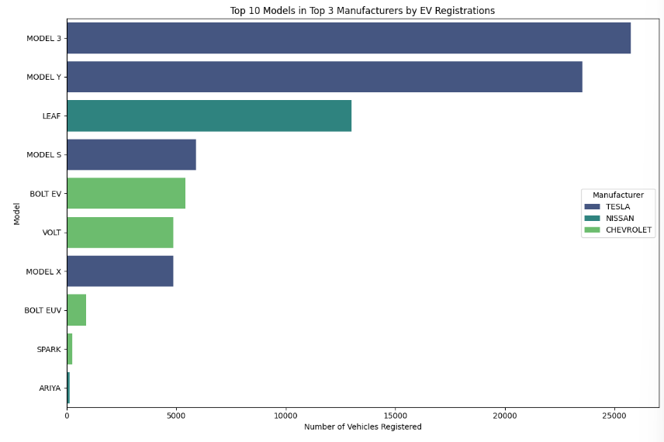

Slide 22
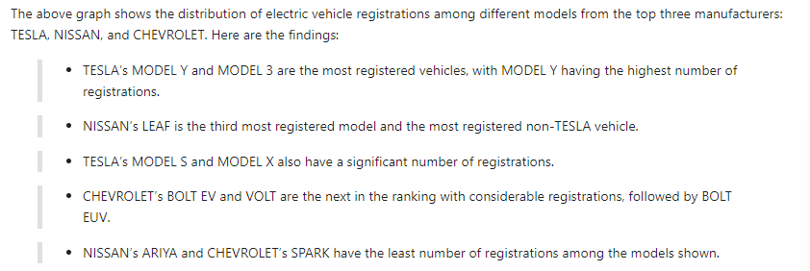
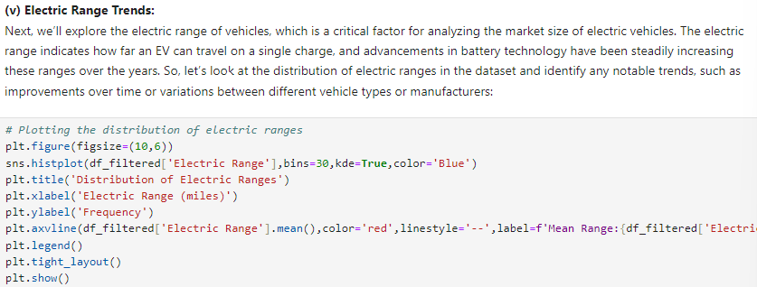

Slide 23
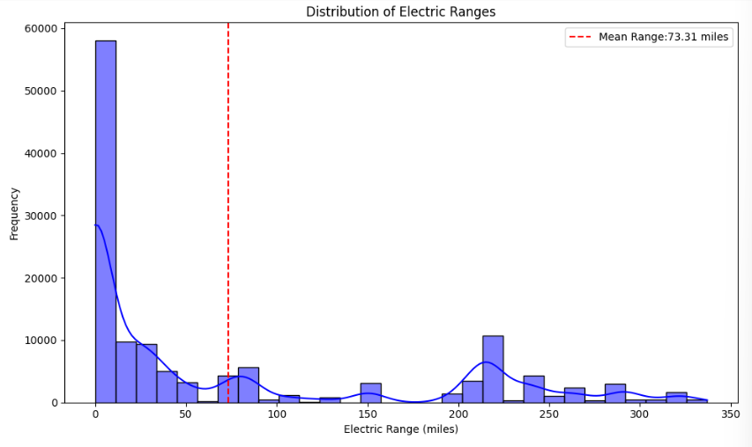
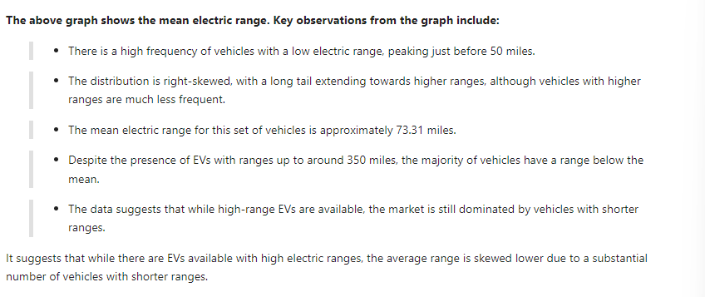

Slide 24
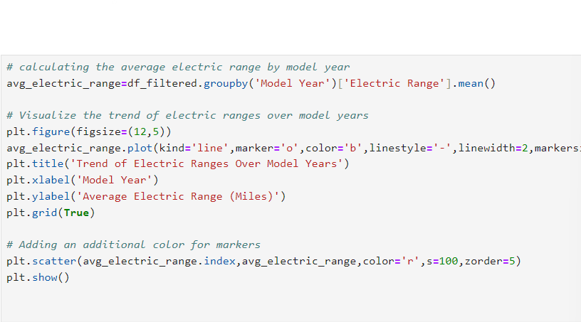
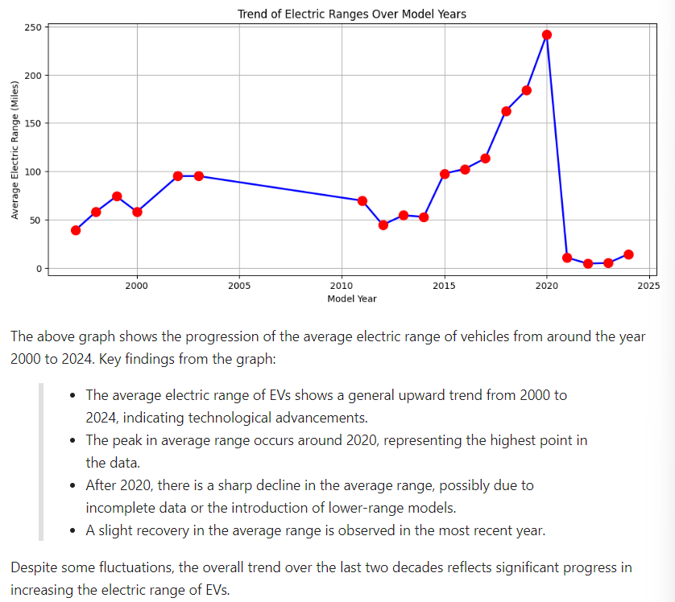

Slide 25

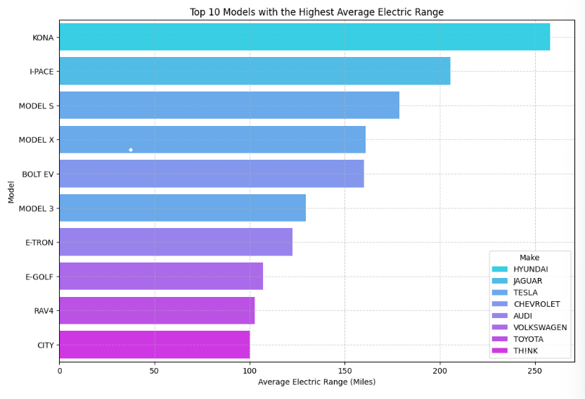

Slide 26
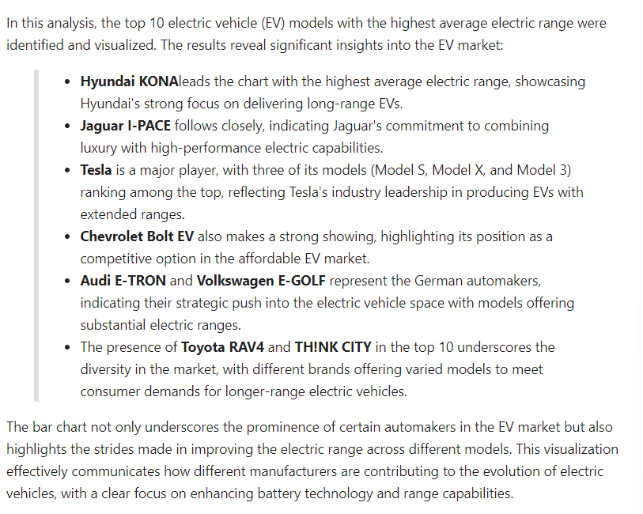


Slide 27
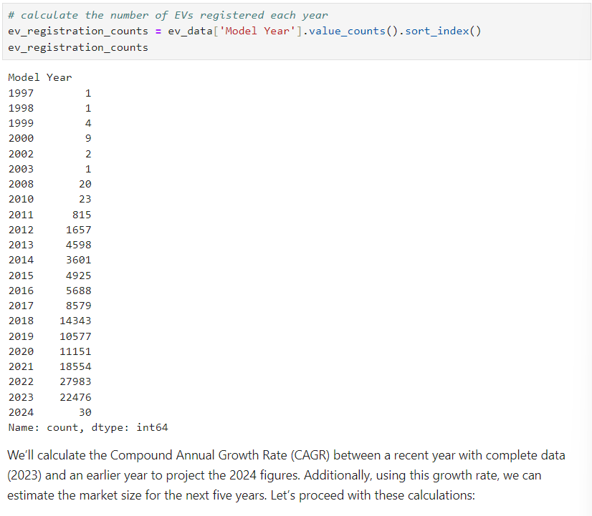

Slide 28


Slide 29
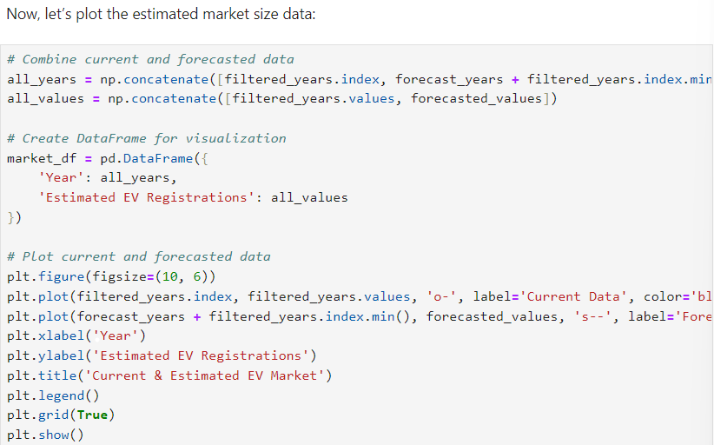
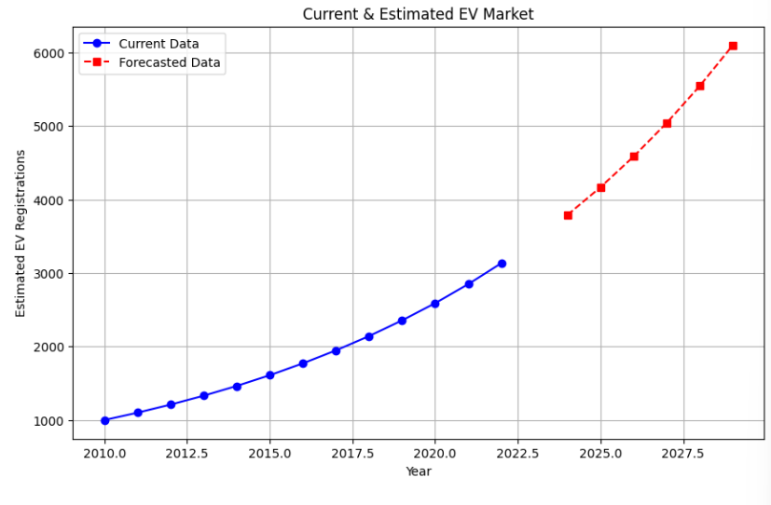

Slide 30
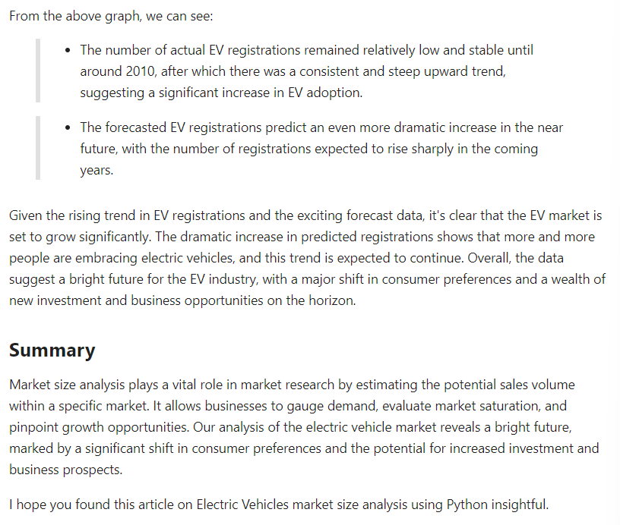

Slide 31



